Slide 1

Internet Traffic Prediction
Group-4
Mentor Name: Parth
Project start Date:24/03/2022
Team members :
1. Poornaraj.C
2. Kunsoth Santhos
3. RamaKrishna Rao Chalasani
4. Sri Charan Sudarshan S
5. Khyati Naik
6. Ismahil M

Slide 2
Business Problem:
Internet Traffic Prediction
Objective:
The goal is to predict internet traffic using a time-series forecasting technique to optimize resource allocation. Many real-world organizations, such as e-commerce retailers like Amazon, Ebay, and others, use such applications to predict and monitor internet traffic. You can forecast the Internet traffic in this project using time-series models as ARIMA and Holt-Winters. This project involves comparing the performance of the time-series prediction models designed of different approaches.

Slide 3
Project Architecture / Project Flow
Understanding the Dataset
Data Cleaning
Missing value analysis
Missing Value Imputation
Visualization
EDA
ARIMA/Holt Model Building
Prediction
Final Deployment

Slide 4
Dataset Details
SL.NO | Details | Description
1 | No of Rows and Columns | Dataset has 173 Rows and 2 Columns
2 | No of Missing values | No Missing Values
3 | Data Types | Object, int
4 | Observation | No duplicate Record found Data is not following any seasonal trends.

Slide 5
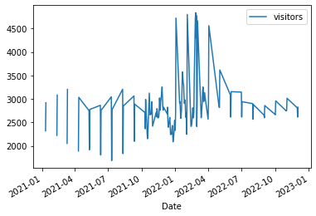
Daily visitor Data is not following any seasonal trends.
Exploratory Data Analysis (EDA)

Slide 6
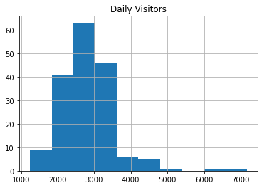
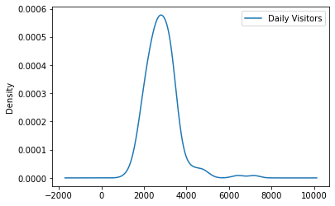
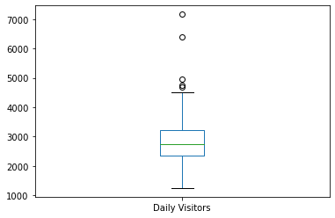
Dataset Visualisation

Slide 7
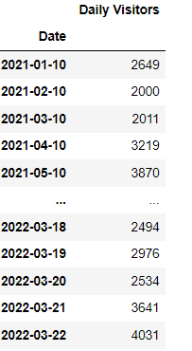
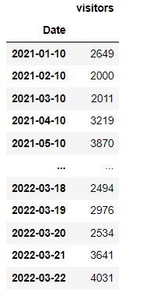
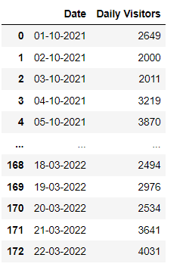

EDA
Date Format Changed to DATETIME Format and Renaming Column Name

Slide 8
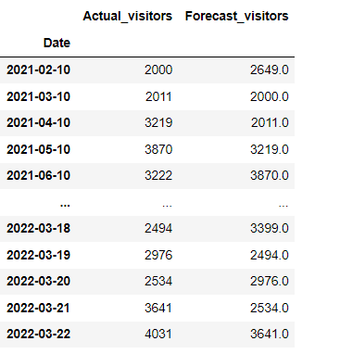
Base Model
Base Model is prepared in which another column forecast visitors Is added.

Slide 9
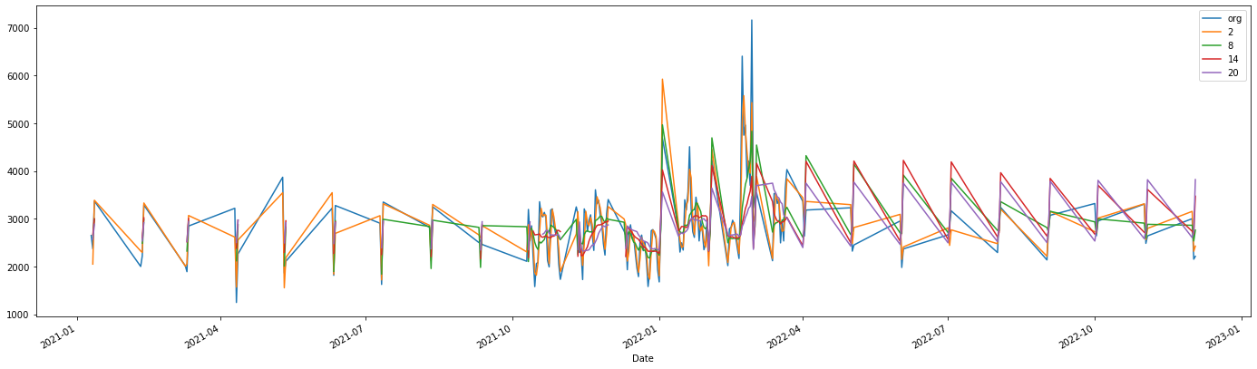
Rolling Analysis

Slide 10
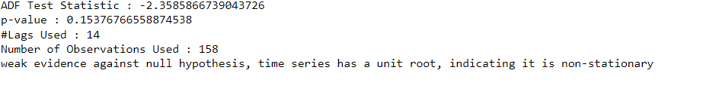
Dickey Fuller Test
Checking whether time series data is stationary or not?
From above result , time series data is not stationary.

Slide 11
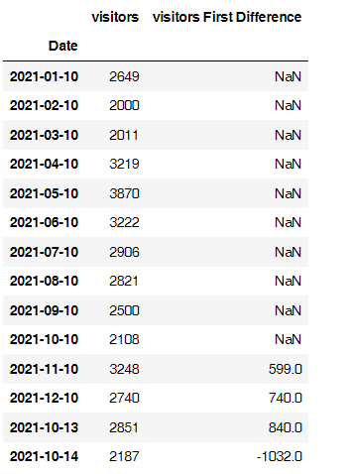
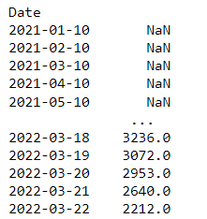
Differencing
Making the time series data stationary

Slide 12
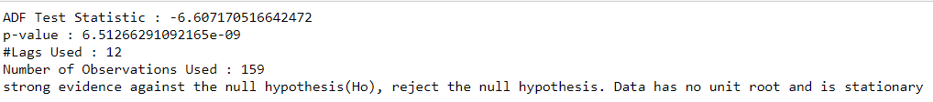
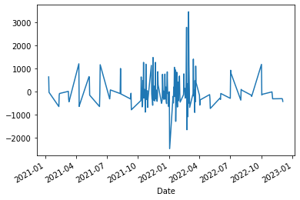
Dickey Fuller Test
Now the time series data is stationary

Slide 13
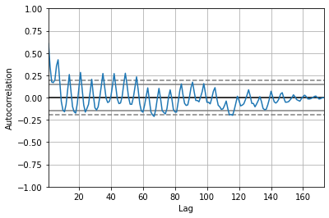
Auto Regressive Model

Slide 14
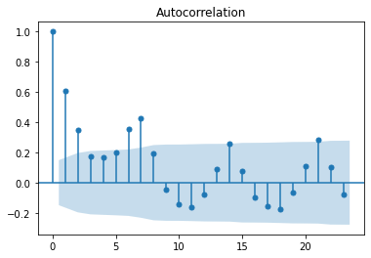
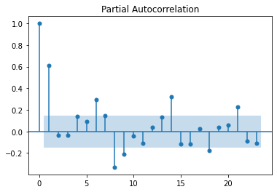
Auto Correlation and Partial Auto Correlation

Slide 15
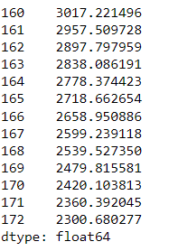
Model Building Holt Method Prediction
MAPE | 20.59
RMSE | 797.8

Slide 16
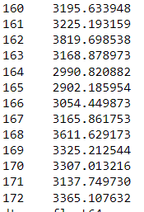
Model Building Holts winter exponential smoothing with additive seasonality and additive trend Prediction
MAPE | 24.439205026852246
RMSE | 762.2672849256012

Slide 17
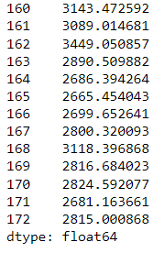
Model Building Holts winter exponential smoothing with multiplicative seasonality and additive trend Prediction
MAPE | 22.974793648316407
RMSE | 757.1978219045552

Slide 18
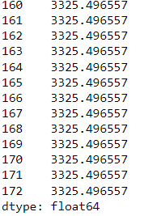
Model Building Simple Exponential Method Prediction
MAPE | 20.155552645558405
RMSE | 646.0348099659459

Slide 19
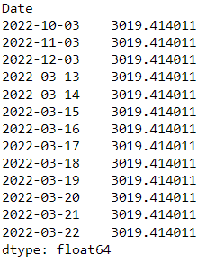
Model Building Linear Model Prediction
MAPE | 19.56927714478019
RMSE | 583.9350049900166

Slide 20
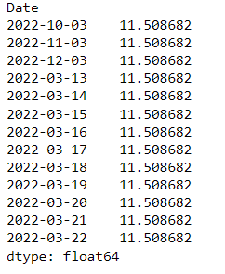
Model Building Exponential Model Prediction
MAPE | 99.60533970102081
RMSE | 99564.98114536368

Slide 21
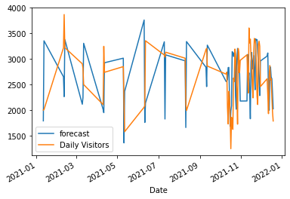
Model Building ARIMA Model # q=1,p=1,d=1 Prediction
MAPE | 18.263770411713075
RMSE | 575.356276757947

Slide 22
Model Building Summary
Model | RMSE | MAPE
Holt Method | 797.8 | 20.59
Holts winter exponential smoothing with additive seasonality and additive trend | 762.26728 | 24.43920502685
Holts winter exponential smoothing with multiplicative seasonality and additive trend | 757.19782 | 22.9747936483
Simple Exponential Method | 646.03480 | 20.15555264555
Linear Model | 583.93500 | 19.569277
Exponential Model | 99564.981 | 99.605
ARIMA Model | 575.3562 | 18.263
Based on RMSE Value we are selecting ARIMA MODEL

Slide 23
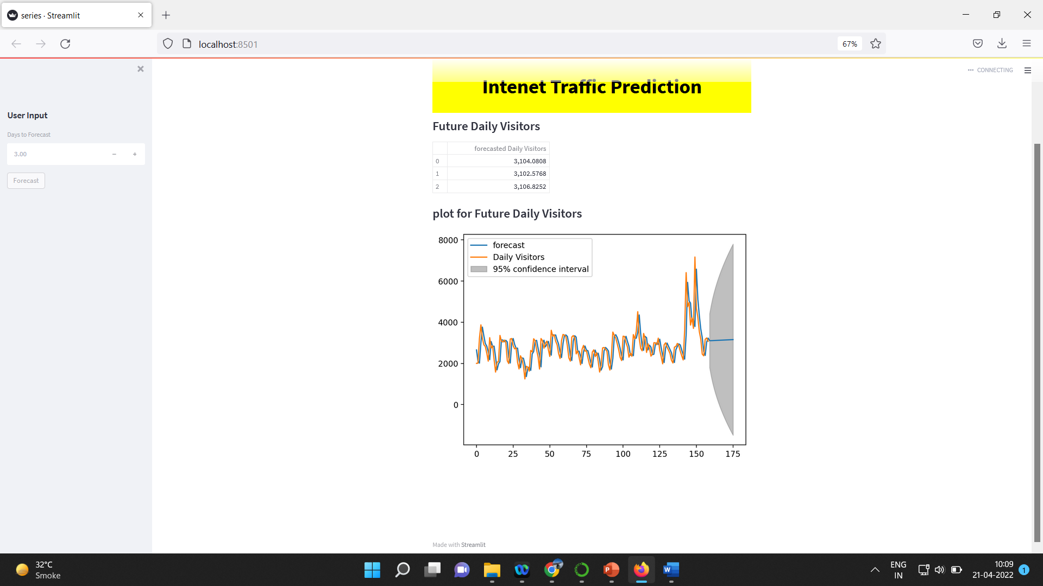
Model Deployment using Stream lit

Slide 24
Thank you

